Slide 1
Machine Learning: Algorithms and Applications
Kernel Methods
Week 5

Slide 2
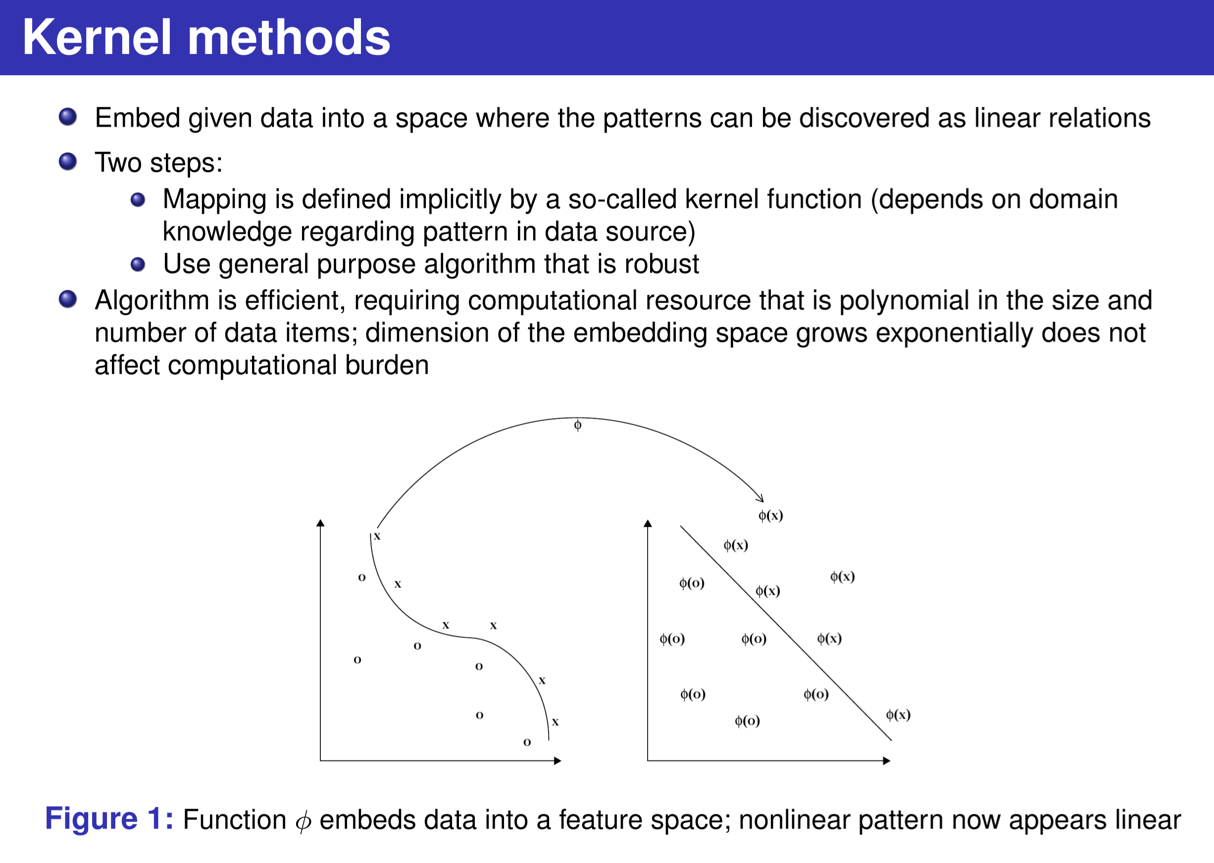
You can not
find a good linear separation to classify the inputs before using kernel method φ.

Slide 3
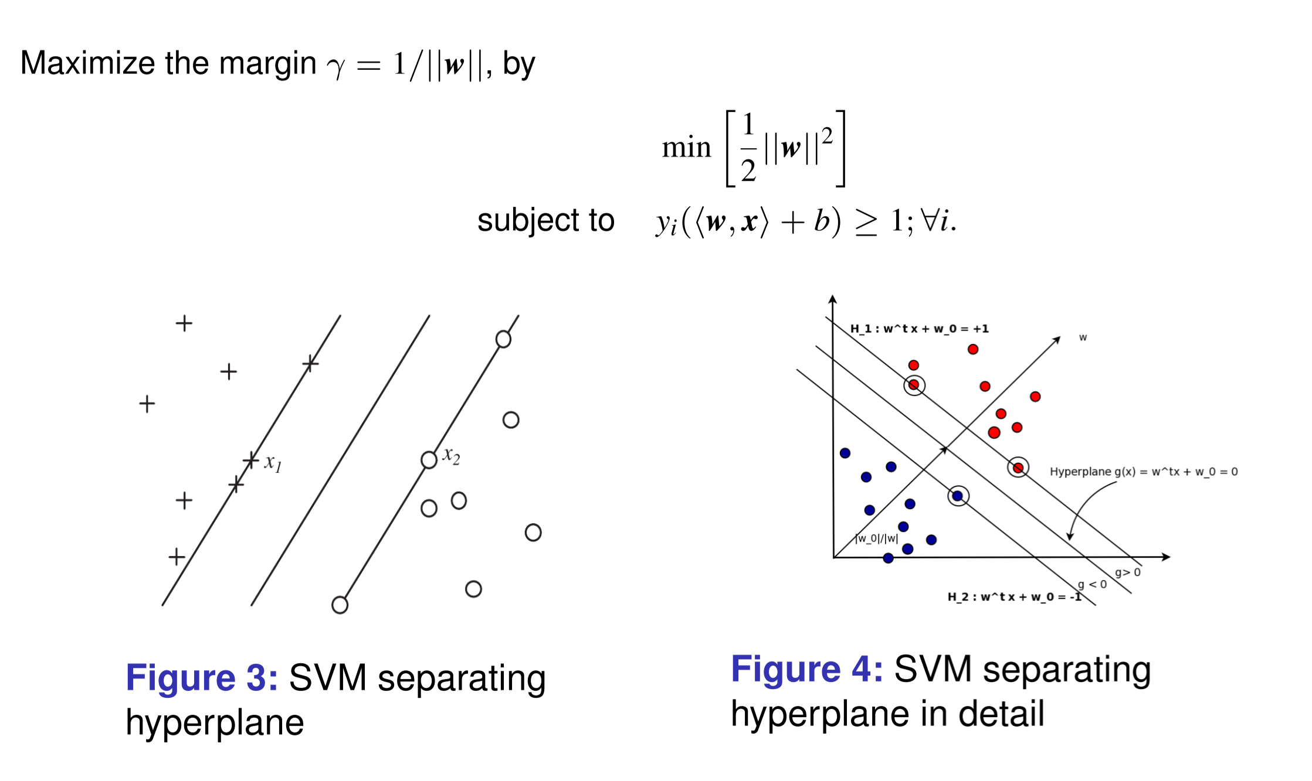
https://zhuanlan.zhihu.com/p/77750026

Slide 4
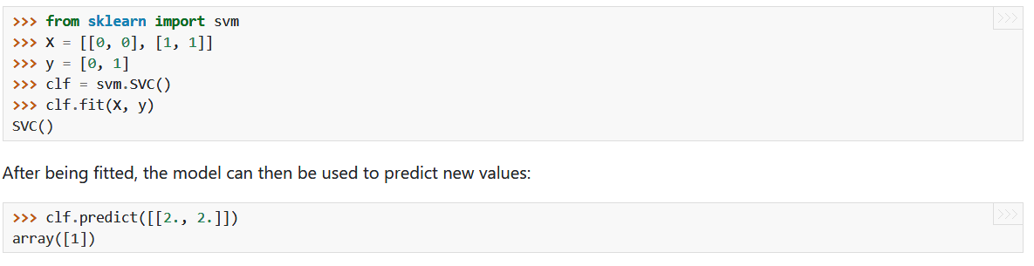
Support Vector Machines
Try the simple codes

Slide 5
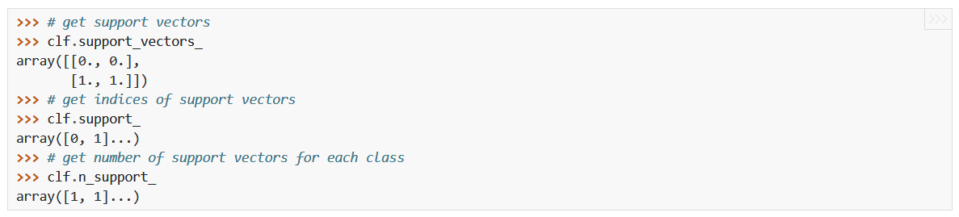
Support Vector Machines
Try the simple codes

Slide 6
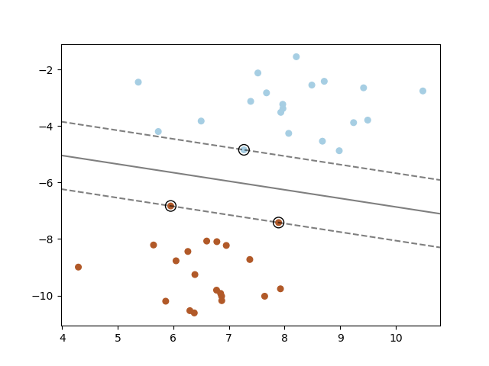
Support Vector Machines
Exercise 2:
Plot the maximum margin separating hyperplane within a two-class separable dataset using a Support Vector Machine classifier with linear kernel.
Check the codes provided for reference.

Slide 7
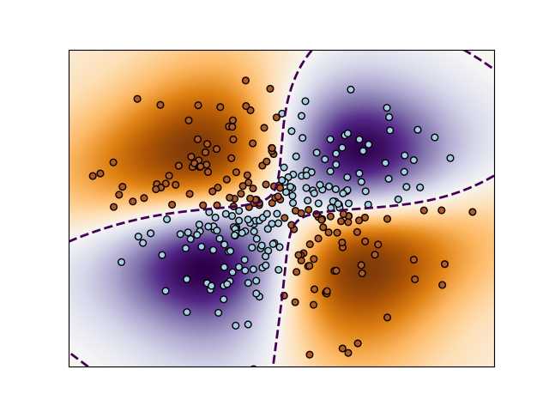
Support Vector Machines
Exercise 3:
Perform binary classification using non-linear SVC with RBF kernel. The target to predict is a XOR of the inputs.
Check the codes provided for reference.

Slide 8
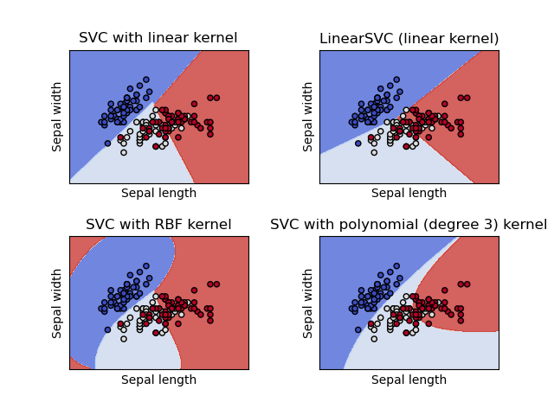
Support Vector Machines
Exercise 4:
Comparison of different linear SVM classifiers on a 2D projection of the iris dataset.
Check the codes provided for reference.

Slide 9
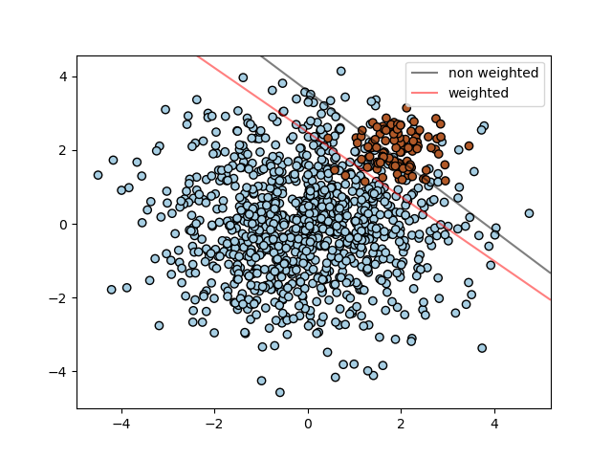
Support Vector Machines
Exercise 5:
Find the optimal separating hyperplane using an SVC for classes that are unbalanced.
Check the codes provided for reference.

